Slide 1
Internship 2020
A.L.I.C.E.
Cornelius Yap, Tiffany Goh, Samuel Lye

Slide 2


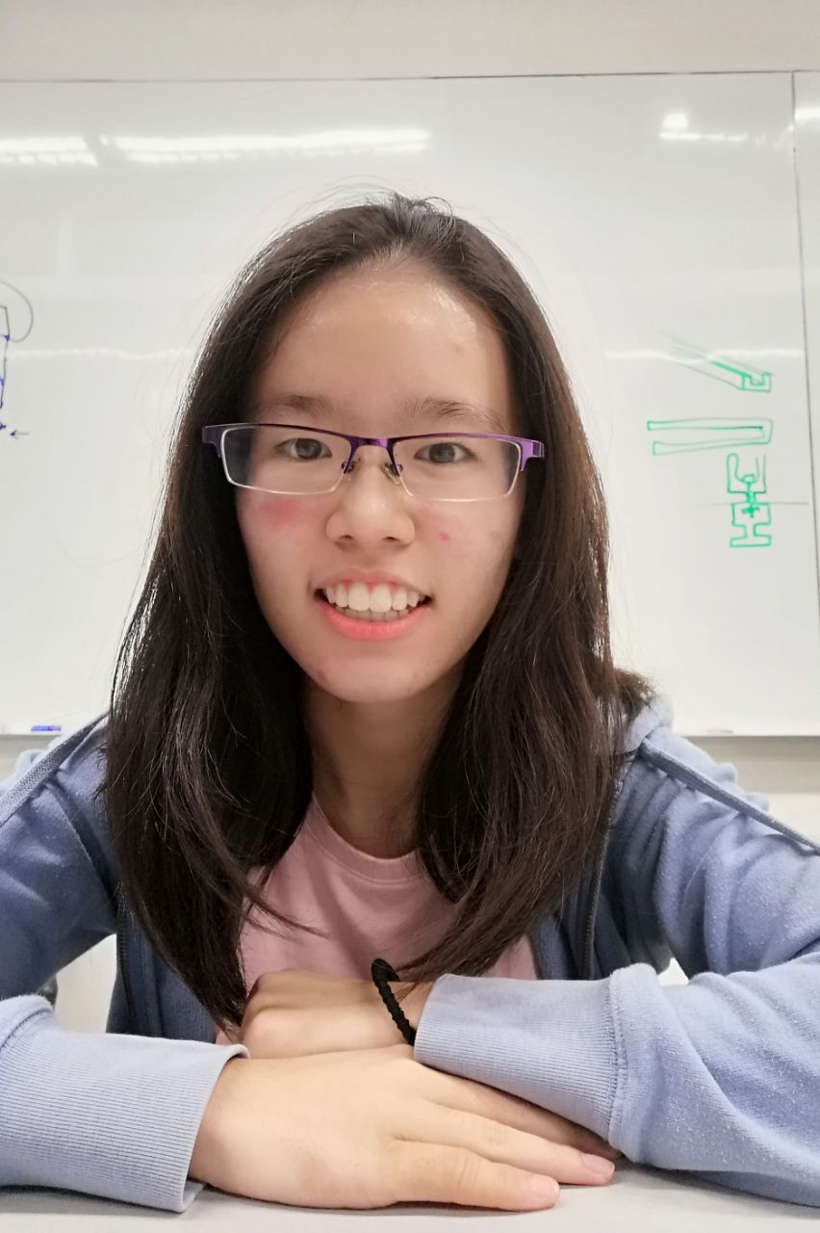
A.L.I.C.E. Team
Cornelius Yap
University: Singapore University of Technology and Design
Major: Computer Science
Interest: Touch Rugby, Game Design, Travelling, Food
Tiffany Goh
University: Singapore University of Technology and Design
Major: Computer Science
Interests: Swimming, Interacting with animals and young children, Algorithms, Travelling
Samuel Lye
University: Cornell University
Major: Economics & Information Science, Minor: Computer Science
Interests: Running, Exercising, Ultimate Frisbee, Coding, Travelling, Photography

Slide 3
Agenda
Overview of A.L.I.C.E.
Objectives
Background
Proposed Implementation Plan
- Key components
- Algorithms Used
- Sample Use Case
- Visualization - Input/Output
Challenges / Enhancements for MP
Exploring State of the Art NLP Technologies
Neural Networks
Attention Modelling

Slide 4
Objectives
To study and research into the most optimal NLP and visualization tools to create an informative text summarizer.
To conduct Proof of Concepts (POC) testing through building of various NLP models using open source tools.
To develop greater understanding and knowledge of fundamental machine learning concepts and NLP tools to create a functioning end product.

Slide 5
Background
Automatic text summarization methods are greatly needed to address the ever-growing amount of text data available online to both better help discover relevant information and to consume relevant information faster.
Analyzing Language Interface Created for Everyone (A.L.I.C.E.) is purposed to summarize text documents and output informative visualization displays that quickly and easily communicate the contents of the text to the user.
The key components of A.L.I.C.E. are the Frontend (React, EngineX), Backend (Flask, UWSGI, and Machine Learning models), as well as the Container (Docker).
Notes:
There is an enormous amount of textual material, and it is only growing every single day. Therefore, there is a great need to reduce much of this text data to shorter, focused summaries that capture the salient details, both so we can navigate it more effectively as well as check whether the larger documents contain the information that we are looking for.

Slide 6
Key Components
Visualisation
D3
Nivo
Word Cloud
Front End
React
NLP Features
Topic Modelling
NER (Named Entity Recogniser)
Sentiment Analysis
Relationship Extraction
Classification (LSTM)
Clustering
DevOps
Dockers
Kubernetes
Back End
NgineX
MongoDB
Flask
NLP Features

Slide 7
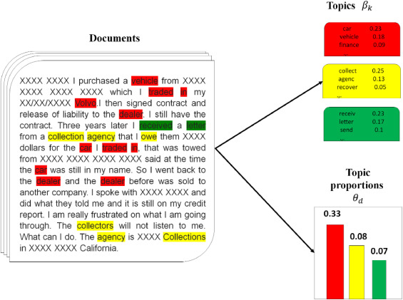
Algorithms Used
Topic Modelling
Latent Dirichlet Allocation (LDA) and TF-IDF
User has to key in the number of topics to be identified. TF-IDF runs through the text to identify the keywords in the document
LDA then runs through all the keywords and find the probability of each particular word belonging to a topic. It then groups the words with the highest probability of belonging to the topic.
The user can then infer what the topics are from the bags-of-words generated.

Slide 8
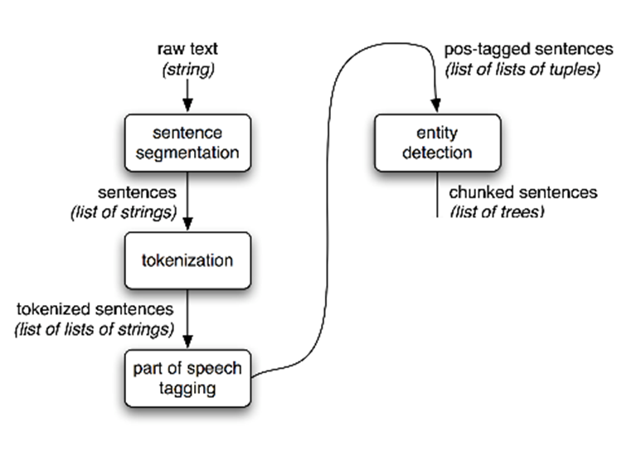
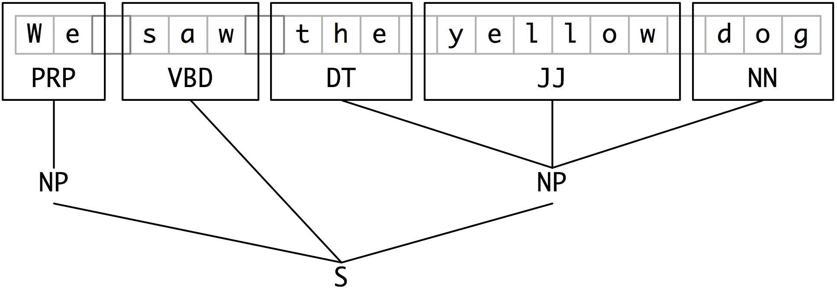
Algorithms Used
Named Entity Recognizer (NER)
NLTK Library
We use NTLK to chunk the text to identify noun phrases with the POS Tag pattern “NP: {<DT>?<JJ>*<NN>}”.
After the noun phrases are identified, it then uses machine learning to determine if the noun phrases is an entity based on previously trained datasets.

Slide 9
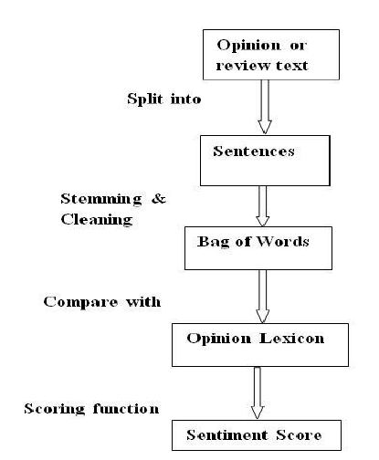
Algorithms Used
Sentiment Analysis
NLTK Sentiment Analysis Libraries, TextBlob
The NLTK Sentiment Analysis Libraries as well as TextBlob uses an unsupervised lexicon based method to determine the polarity and objectivity of the text.
It maintains a lexicon which is a dictionary of words that are given a score based on how objective the word is and whether it is a positive or negative word.
The NLTK tool then searches the scores for all the words in the text and calculate the overall polarity and objectivity of the text.

Slide 10
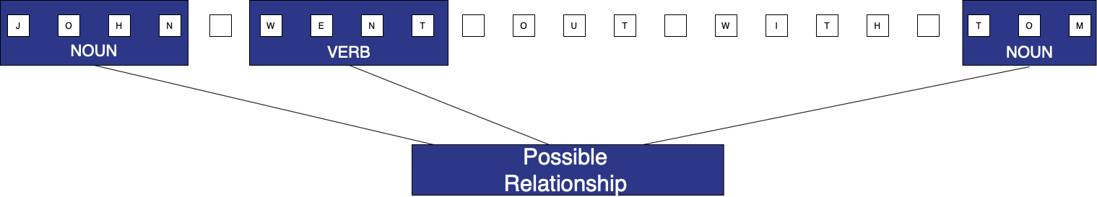
Algorithm Used
Relationship Extraction
As there are no available libraries out there that can helps us perform relationship algorithms, we will have to come up with a custom algorithm ourselves
Our algorithm aims to identify and pick up the relationship between two entities based on the contextual clues given in a single sentence. We will be using Stanford NLP Parser to POS-Tag the tokens in the given sentence and use the Tags to identify certain patterns that might indicate a relationship.

Slide 11

Sample Use Case
Analysis of news articles to monitor for possible Covid-19 cure
“A team of local researchers are working on a Covid-19 vaccine that can be modified within three weeks to tackle the Sars-CoV-2 virus if it mutates, and they are hoping for human trials within six months.Home-grown Esco Aster is developing the vaccine with United States biotechnology company Vivaldi Biosciences, tapping chimeric vaccines which are created by merging proteins from different viruses.The work-in-progress vaccine, currently named Esco Aster DeltaCov, was constructed by joining antigens from the Sars-CoV-2 virus - which causes Covid-19 - with a protein backbone from the flu virus.”

Slide 12
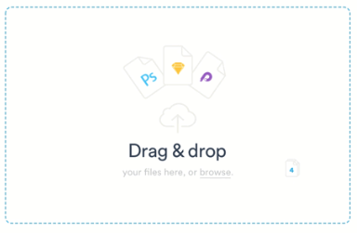
Visualisation (Input)
We envisage ALICE to have a simple interface to provide a transformed user experience from the conventional designs.
Nevertheless, inputs for A.L.I.C.E. require users to select the environment of the ML models, i.e. domain, number of topics, and number of words per topic and this will be done in a settings page
Different NER models are trained on different domains and thus, have different output
Topic modelling requires the input to specify the number of topics and words per topic to generate an output
A.L.I.C.E.
Notes:
Different NER models are trained on different domains and thus, have different output
The latent Dirichlet allocation (LDA) technique is a generative probabilistic model where each document is assumed to have a combination of topics

Slide 13
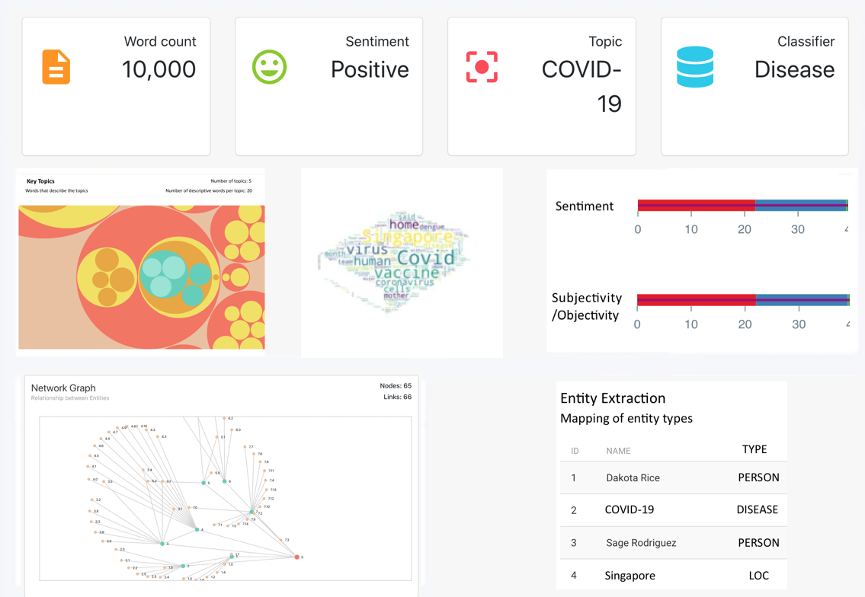
Visualisation (Output)
Negative
Positive
Word
Topic

Slide 14
Application
Quick summary of documents from different domains
Comprehensive visualisation tool that maps out the relationship between different entities in the text
Applicable to the security domain, where our model if trained on security-related domain, would be able to extract key information from sensitive documents and allow users to quickly understand the security concerns with regards to the documents.

Slide 15
Challenges
Different domains of text documents will mean that different ML models will have to be trained under those domains with a large enough dataset.
We need to train and create our own relation detection model as there is no extensive NLP library that provides this service. This would involve annotating a large amount of test and training data, as well as creating the resulting network diagram.
We need to ensure that A.L.I.C.E. is able to effectively “tell a story” and provide a flow of information to the user.

Slide 16
Enhancements for MP
Human Computer Interaction
- Explore/implement HCI techniques to enhance user experience
Clustering
Given a group of documents, group documents with similar topics
Using Tf-idf as a distance measurement
The algorithm used is K means
Attention
Used to improve the accuracy of the classifier
Dockers
Implement Containers to provide a consistent environment for all the different components, libraries and dependencies

Slide 17
Recurrent Neural Networks
Multilayer Perceptrons (MLP) | Convolutional Neural Networks (CNN) | Recurrent Neural Networks (RNN)
Designed for classification and regression prediction problems | Designed to map image data to an output variable | Designed to work with sequence prediction problems
An RNN is different as it introduces the concept of memory through the form of a different type of reverse links.
The inclusion of links between layers in the reverse direction allows for feedback loops, which are used to help learn concepts based on context.
Long Short-Term Memory Network (LSTM) is a type of RNN that is capable of learning long-term relationships.

Slide 18


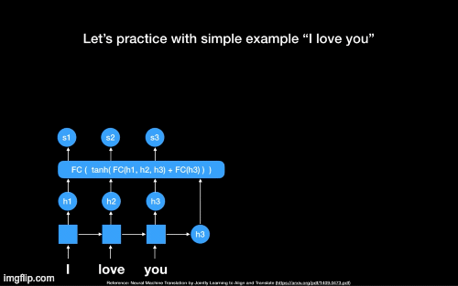
Attention Model
Recurrent Neural Network (RNN) | Attention Model
Uses fixed length vector Rigidity | Uses context vector Flexibility

Slide 19
Applications of Attention Models
Neural Image Caption Generation with Visual Attention
Hierarchical Attention Network for Document Classification
Attention-based Bidirectional Long Short-Term Memory Networks for Relation Classification
Effective Approaches to Attention-based Neural Network Translation
Notes:
Our model has two distinctive characteristics: (i) it has a hierarchical structure that mirrors the hierarchical structure of documents; (ii) it has two levels of attention mechanisms applied at the wordand sentence-level, enabling it to attend differentially to more and less important content when constructing the document representation.
Likewise, in an image captioning problem, some regions of the input image may be more relevant for generating the next word in the caption.

Slide 20
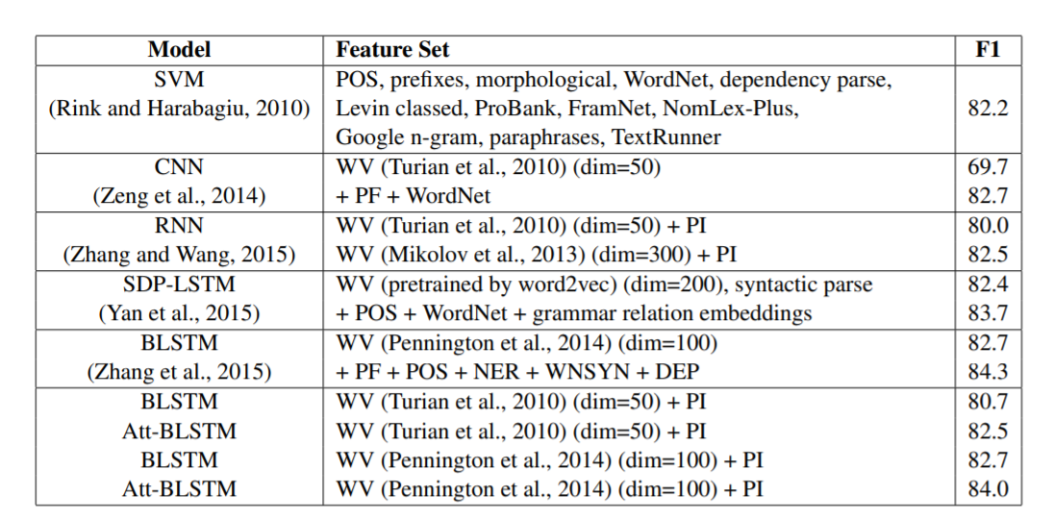
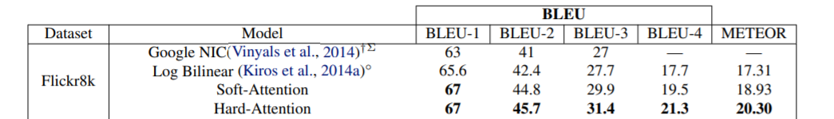
Comparison between models

Slide 21
Internship 2020
A.L.I.C.E.
Thank you!

